Slide 1
An Introduction to Data Visualisation and Visual Demography in R 22-23 October 2014 Hilton Grosvenor Hotel, Glasgow
Dr Jon Minton
Applied Quantitative Methods Network (AQMeN)
University of Glasgow
Jonathan.minton@glasgow.ac.uk

Slide 2
Structure of this workshop
Two Days; two distinct parts per day
Day One:
Part One: Theory of Data Visualisation
Part Two: Introduction to R
R Installation Clinic
Day Two:
Part One: ggplot2
Part Two: Visual Demography
Scope to work more on ggplot2 if preferred

Slide 3
Guiding Principles and Structure of this workshop
Theoretical
Why? What?
Practical
How?

Slide 4
Guiding Principles and Structure of this workshop
Day 1: Part 1
Theoretical
Why? What?
Day 2: Part 1
Day 2: Part 2
Practical
How?
Day 1: Part 2

Slide 5
Approach for this workshop
INTERRUPTIONS are fine
Talking concentrated in the first half of the first day
Approach to the practicals:
Organic: if it’s useful and there’s time, keep going
Frequent feedback: check in with the group every 10 or so minutes
Nobody left behind
Learning as teaching; teaching as learning

Slide 6
Introductions
Who are you?
Where are you from and what do you do?
Why are you interested in data visualisation?
What do you understand by the term ‘data visualisation’?
What do you want to achieve by the end of the workshop?
What do want to achieve regarding data visualisation in the longer term?

Slide 7
Cutting to the Chase: Main Arguments
Information visualisation is not data visualisation. (But data visualisation is a type of information visualisation)
Data visualisation has a grammar and comes in layers
We can’t have too much information, but we can have too much data; data visualisation (and statistics) is about making data more informative
Good data visualisations are good matches
You need to wear Three Hats (and will spend most of your time wearing a Hard Hat)

Slide 8

(Mis)information is Beautiful

Slide 9
(Mis)information is Beautiful
Tim Harford
Economist
Presenter of Radio 4’s More or Less
Argues we should beware of data visualisation
Data visualisation dazzles, rather than informs
http://view6.workcast.net/?pak=8615439470431294#

Slide 10
My position
I agree (mostly)
But you’re using the wrong term.
You’re talking mainly about ‘infographics’ rather than data visualisations
Infographics are NOT data visualisations
Infographics are information visualisations
Data visualisations are information visualisations
But (most) infographics are not data visualisations
So, what makes a data visualisation a data visualisation rather than some other kind of information visualisation?

Slide 11
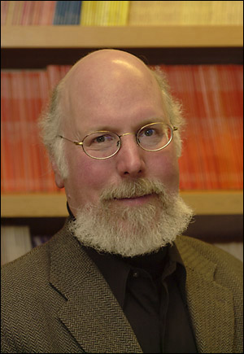

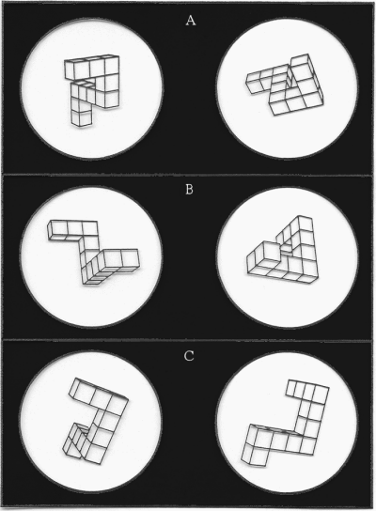

Thought is Visual
Stephen
Kosslyn
George
Lakoff

Slide 12
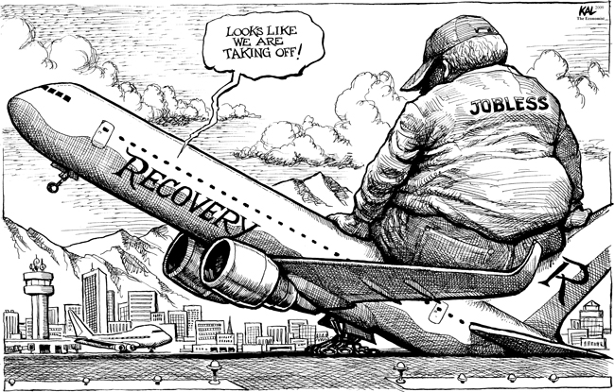
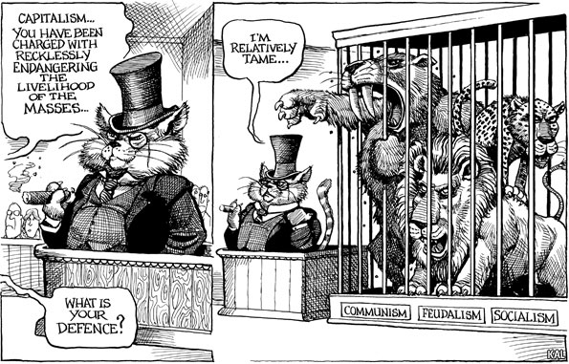
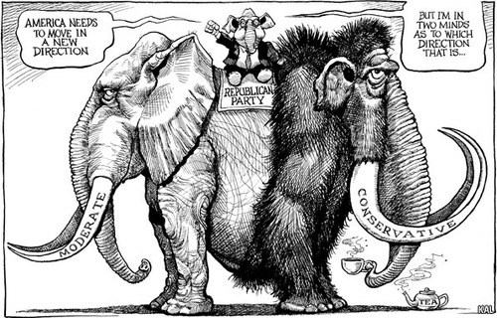
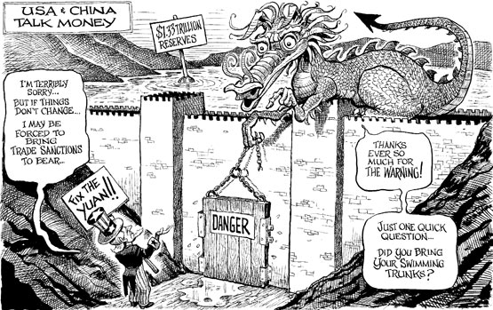
Examples

Slide 13
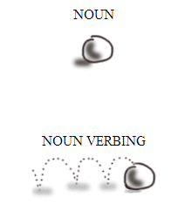
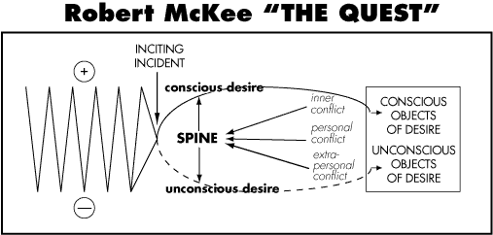
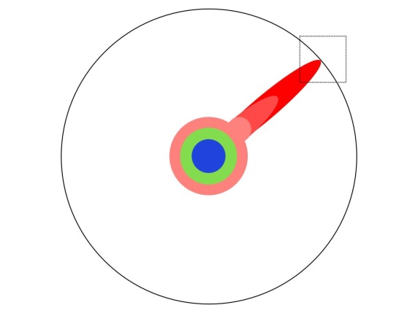
Examples

Slide 14
Time is spatial...
Then
Now

Slide 15


...but is it cultural?
Then
Now
The quick brown fox jumps over the lazy dog
Now
Then
Now
Then

Slide 16
Statistics is...
Data
A summary of the data
A model used to summarise the data
Inferences, predictions, projections based on the model used to summarise the data

Slide 17
Statistics is...
(mostly)
DATA
reduction

Slide 18
Statistical Inference and Data Visualisation
Complementary Roles
Statistical Inference lowers the hurdle
Data Visualisation lets people jump higher

Slide 19
Data Visualisation is…
… you tell me.
Let’s (briefly) explore the history of data visualisation

Slide 20
History of Data Visualisation
The Milestones Project
1644: First data graph (Michael Langren)
1701: First contour map (Edmond Halley)
1752: Developments in contour maps (Phillippe Buache)
1753: Annotated timelines (Jacques Barbeu-Dubourg)
1765: Annotated biographical timelines (Joseph Priestley)
1786: Bar charts, and line graphs (William Playfair)
Let’s explore Playfair’s visualisations in more detail...

Slide 21
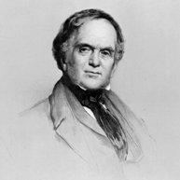
William Playfair
Born 1759
Died 1823
Architect
Mathematician
Economist

Slide 22
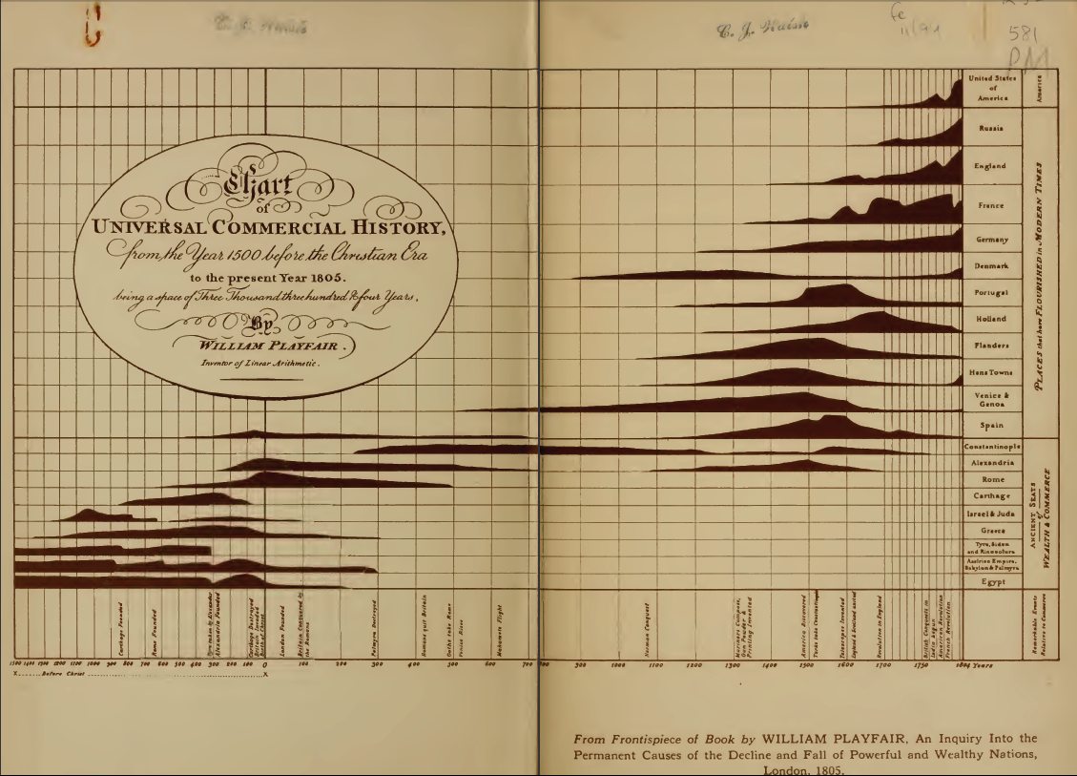
William Playfair

Slide 23
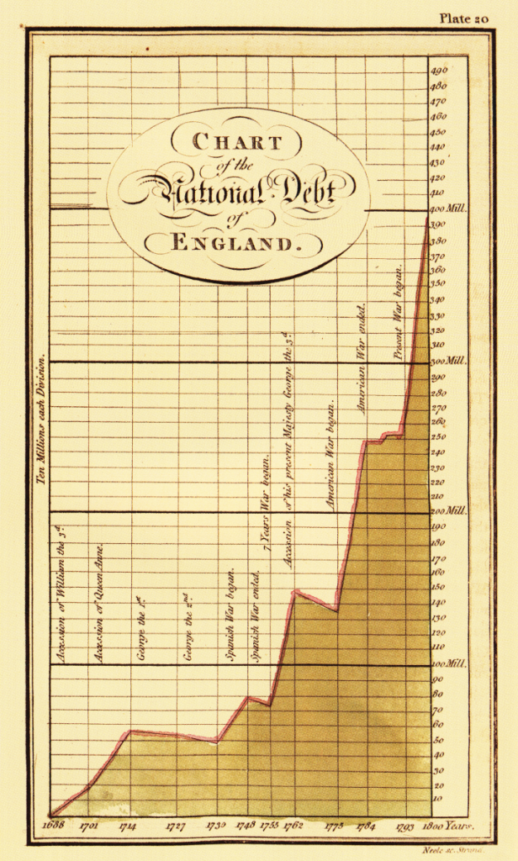
William Playfair
Note the use of
proportions
Visualisations as rhetoric

Slide 24

Charles Minard
Born 1781
Died 1870
Civil Engineer until 1851
Retired* from 1852
* This is when he produced most of his visualisations

Slide 25

Charles Minard
“...the best statistical graphic ever drawn”? – Edward Tufte

Slide 26
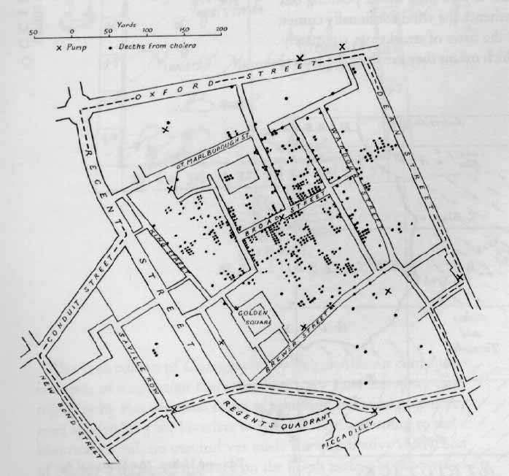
History of Data Visualisation
The Milestones Project (Continued)
1855: Dot maps to identify origin of a cholera outbreak in London (John Snow)
Dots save lives

Slide 27
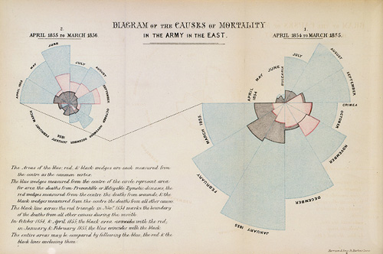
History of Data Visualisation
The Milestones Project (Continued)
1857: Polar area charts AKA coxcombs (Florence Nightingale)
Wedges save lives

Slide 28

John Tukey
Born 1915
Died 2000
Mathematician
(Electronic Engineer)
Contributions to data visualisation:
Box plots
‘Exploratory Data Analysis’

Slide 29
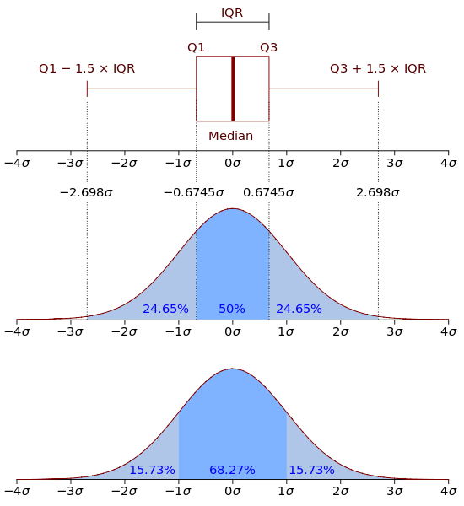
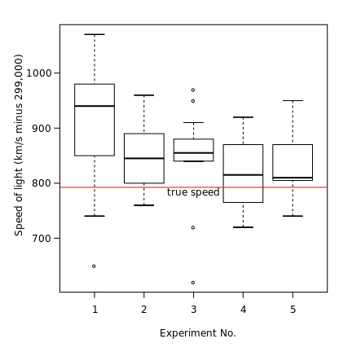
John Tukey
Box plots
Visual representation of a number of key statistics used to summarise a sample of observations

Slide 30
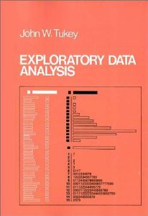
John Tukey
Exploratory Data Analysis
Crudely:
A series of (mainly visual) methods for trying to be less dependent on summary statistics and the assumptions used to construct them.

Slide 31
Why use visualisation for Exploratory Data Analysis?
I |  | II |  | III |  | IV
x | y | x | y | x | y | x | y
10.0 | 8.04 | 10.0 | 9.14 | 10.0 | 7.46 | 8.0 | 6.58
8.0 | 6.95 | 8.0 | 8.14 | 8.0 | 6.77 | 8.0 | 5.76
13.0 | 7.58 | 13.0 | 8.74 | 13.0 | 12.74 | 8.0 | 7.71
9.0 | 8.81 | 9.0 | 8.77 | 9.0 | 7.11 | 8.0 | 8.84
11.0 | 8.33 | 11.0 | 9.26 | 11.0 | 7.81 | 8.0 | 8.47
14.0 | 9.96 | 14.0 | 8.10 | 14.0 | 8.84 | 8.0 | 7.04
6.0 | 7.24 | 6.0 | 6.13 | 6.0 | 6.08 | 8.0 | 5.25
4.0 | 4.26 | 4.0 | 3.10 | 4.0 | 5.39 | 19.0 | 12.50
12.0 | 10.84 | 12.0 | 9.13 | 12.0 | 8.15 | 8.0 | 5.56
7.0 | 4.82 | 7.0 | 7.26 | 7.0 | 6.42 | 8.0 | 7.91
5.0 | 5.68 | 5.0 | 4.74 | 5.0 | 5.73 | 8.0 | 6.89
The Anscombe Quartet (1973)

Slide 32
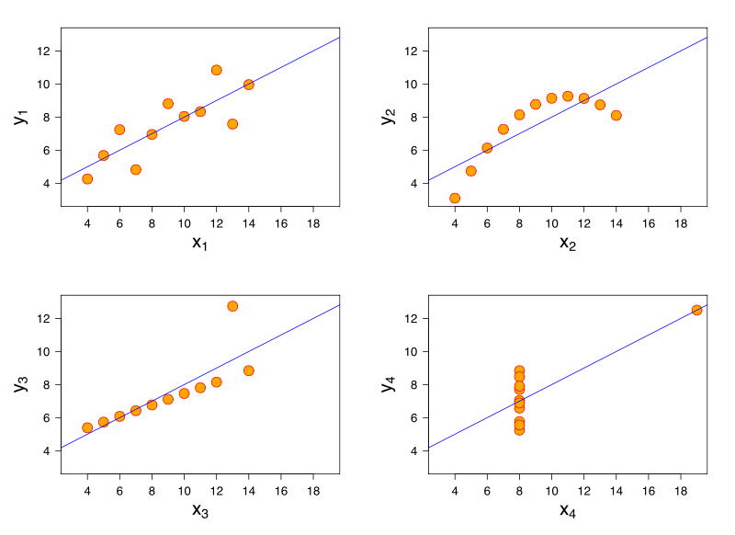
Why use visualisation for Exploratory Data Analysis?
I |  | II |  | III |  | IV
x | y | x | y | x | y | x | y
10.0 | 8.04 | 10.0 | 9.14 | 10.0 | 7.46 | 8.0 | 6.58
8.0 | 6.95 | 8.0 | 8.14 | 8.0 | 6.77 | 8.0 | 5.76
13.0 | 7.58 | 13.0 | 8.74 | 13.0 | 12.74 | 8.0 | 7.71
9.0 | 8.81 | 9.0 | 8.77 | 9.0 | 7.11 | 8.0 | 8.84
11.0 | 8.33 | 11.0 | 9.26 | 11.0 | 7.81 | 8.0 | 8.47
14.0 | 9.96 | 14.0 | 8.10 | 14.0 | 8.84 | 8.0 | 7.04
6.0 | 7.24 | 6.0 | 6.13 | 6.0 | 6.08 | 8.0 | 5.25
4.0 | 4.26 | 4.0 | 3.10 | 4.0 | 5.39 | 19.0 | 12.50
12.0 | 10.84 | 12.0 | 9.13 | 12.0 | 8.15 | 8.0 | 5.56
7.0 | 4.82 | 7.0 | 7.26 | 7.0 | 6.42 | 8.0 | 7.91
5.0 | 5.68 | 5.0 | 4.74 | 5.0 | 5.73 | 8.0 | 6.89
The Anscombe Quartet (1973)

Slide 33
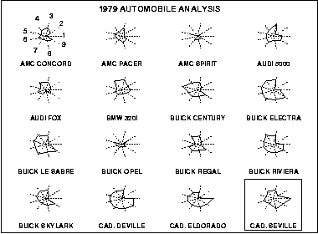
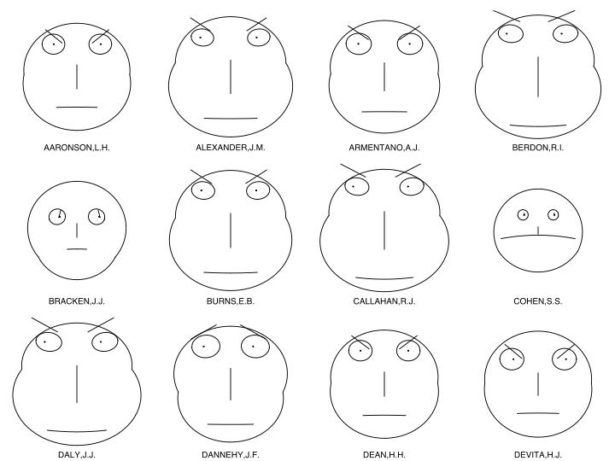
History of Data Visualisation
The Milestones Project (Continued)
1971: Irregular polygons AKA Star Plots (Friedmen & Siegel)
1973: Cartoon faces (Herman Chernoff)

Slide 34
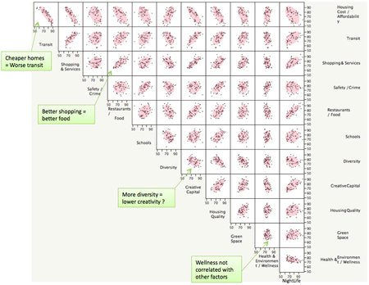
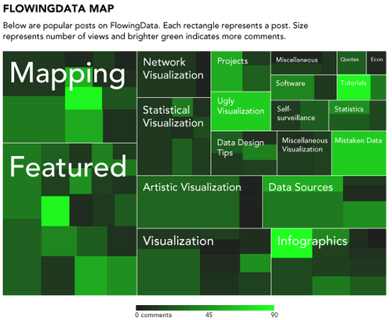
History of Data Visualisation
The Milestones Project (Continued)
1975: Scatterplot matrices – tables and graphs (John Hartigan)
1981: Mosaic plots (Hartigan & Kleiner)

Slide 35

Edward Tufte
Born 1942
Statistician
Sculptor
Advisor to Obama
Contributions to data visualisation
Conceptual Tools
Data Ink Ratios
Lie Factors
Chart Junk
Visualisations
Small multiples
Sparklines

Slide 36
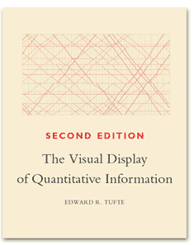
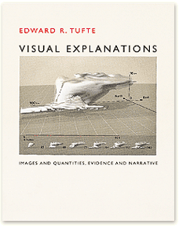
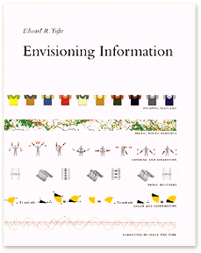

Books by Edward Tufte

Slide 37
Data Visualisation is…
You tell me. (Again)
Nudging questions:
What is not a data visualisation?
Data visualisation is, or data visualisations are?

Slide 38
Data Visualisation is…
…the development and consistent application of rules for mapping between data and graphics.
(equivalently) ... using quantitative (statistical) data as instructions for the production of images.
A necessary condition for something to be a data visualisation; but not a sufficient condition for something to be a good data visualisation

Slide 39
The Three Hats
Three different skill sets
Three different mind sets
What are they?

Slide 40
The Three Hats
Scientist
Artist
Engineer

Slide 41
The Engineer must have broad shoulders
S
A
E

Slide 42
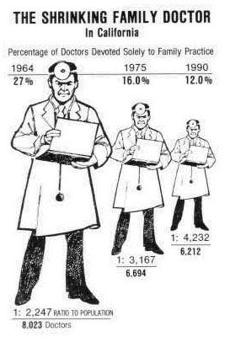
Are your visualisations... lying?
What’s the ‘lie factor’?
- Edward Tufte
“
The representation of numbers, as physically measured on the surface of the graphic itself, should be directly proportional to the quantities represented
”
Tufte 1991
S
A
E

Slide 43
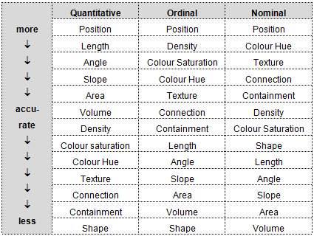
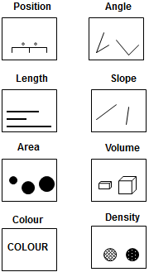
Are your visualisations... Accurately interpretable?
Cleveland W & McGill R (1985), ‘Graphical Perception and Graphical Methods for Analysing Scientific Data’, Science (229) 4716: 828-833
S
A
E

Slide 44
Are your visualisations... Sensible?
S
A
E

Slide 45
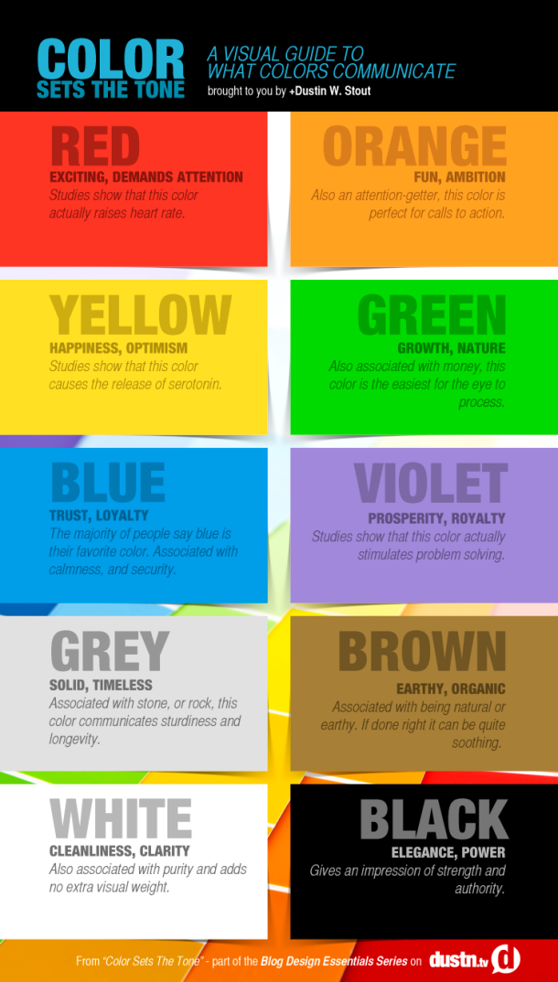
Visualisations
and colour
S
A
E

Slide 46
Why is Facebook blue?
Colour and
accessibility
S
A
E

Slide 47
Colour and
appropriateness
to variables
S
A
E

Slide 48
Circles and Squares: A faultline?
S
A
E

Slide 49
Data Management
Very important
Useful things to know
Importing from plain text
Importing from web tables
Exporting
Cleaning
Formatting
Rearranging Data
S
A
E

Slide 50
Tidy Data
Database theory
Can we distinguish parts of a table into:
Keys
Something that uniquely identifies an observation
Variables
Something that we measure when we make observations
Values
The result of measuring a specific variable in a specific observation
S
A
E

Slide 51
Making Data ‘Tidy’
What are the keys, variables, and values?
Surname | First name | Month of trial | Height | Condition | Weight
Smith | Mary | 1 | 78 | Healthy | 45
Smith | John | 2 | 62 | Sick | 52
Jones | William | 1 |  | Healthy
Jones | William | 2 | 86 |  | 84
Smith | Mary | 3 | 78 | Sick | 43
S
A
E

Slide 52
Making Data ‘Tidy’
S
A
E
Variables
Surname | First name | Month of trial | Height | Condition | Weight
Smith | Mary | 1 | 78 | Healthy | 45
Smith | John | 2 | 62 | Sick | 52
Jones | William | 1 |  | Healthy
Jones | William | 2 | 86 |  | 84
Smith | Mary | 3 | 78 | Sick | 43
Values
Keys

Slide 53
Keys: Unique identifiers of observations
Surname | First name | Month of trial | Key
Smith | Mary | 1 | Smith_Mary_1
Smith | John | 2 | Smith_John_2
Jones | William | 1 | Jones_William_1
Jones | William | 2 | Jones_William_2
Smith | Mary | 3 | Smith_Mary_3
S
A
E

Slide 54
Keys: Unique identifiers of observations
Surname | First name | Month of trial | Key
Smith | Mary | 1 | Smith_Mary_1
Smith | John | 2 | Smith_John_2
Jones | William | 1 | Jones_William_1
Jones | William | 2 | Jones_William_2
Smith | Mary | 3 | Smith_Mary_3
S
A
E

Slide 55
Long format data
‘Clay’: Something that is easy to reform into many alternative structures
A good format for data storage and archiving
S
A
E

Slide 56
‘Casting’ Data
 |  | Month
 |  | 1 | 2 | 3 | 4 | 5 | 6 | 7 | 8 | 9 | 10
Person | A | 78 | 79 | 75 | 69 | 64 | 65 | 62 | 59 | 59 | 62
 | B | 56 | 59 | 62 | 61 | 55 | 58 | 63 | 67 | 69 | 62
 | C | 92 | 99 | 105 | 101 | 104 | 111 | 114 | 105 | 97 | 99
 | D | 48 | 49 | 49 | 56 | 59 | 55 | 63 | 66 | 61 | 52
 | E | 66 | 70 | 64 | 62 | 68 | 63 | 64 | 64 | 62 | 67
 | F | 99 | 98 | 87 | 88 | 86 | 85 | 86 | 82 | 79 | 85
 | G | 154 | 160 | 161 | 154 | 148 | 149 | 142 | 139 | 137 | 133
S
A
E

Slide 57
Adding Summary Margins
Person | 1 | 2 | 3 | 4 | 5 | 6 | 7 | 8 | 9 | 10
A | 100 | 101 | 96 | 88 | 82 | 83 | 79 | 76 | 76 | 79
B | 100 | 105 | 111 | 109 | 98 | 104 | 113 | 120 | 123 | 111
C | 100 | 108 | 114 | 110 | 113 | 121 | 124 | 114 | 105 | 108
D | 100 | 102 | 102 | 117 | 123 | 115 | 131 | 138 | 127 | 108
E | 100 | 106 | 97 | 94 | 103 | 95 | 97 | 97 | 94 | 102
F | 100 | 99 | 88 | 89 | 87 | 86 | 87 | 83 | 80 | 86
G | 100 | 104 | 105 | 100 | 96 | 97 | 92 | 90 | 89 | 86
Mean | 100 | 104 | 102 | 101 | 100 | 100 | 103 | 102 | 99 | 97
S
A
E

Slide 58
A Question
What is a good data visualisation?

Slide 59
The Answer
It depends.
Good data visualisations don’t have to be:
Quick
Simple
Easy to understand
Original
Eye-catching
What matters is how well matched the visualisation is with the audience

Slide 60
Two types of audience
Internal/Specialist
Data Visualisation as Exploratory Data Analysis
A recursive, two-way process
External/Generalist
‘Narrative’ Data Analysis
A one-way process

Slide 61

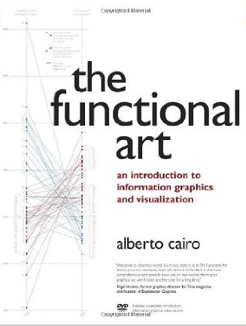
The Complexity Challenge
Unidimensional
Multidimensional
Light
Dense
Familiar
Original
Figurative
Abstract
Decorative
Functional
Redundancy
Novelty

Slide 62
Data Visualisation is...
... using quantitative (statistical) data as instructions for the production of images.
QUESTIONS
What data?
How are the data converted into instructions?
Who/what is being instructed?
What image?

Slide 63
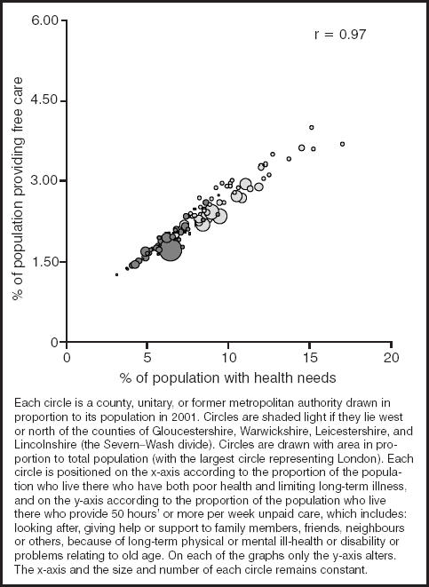
As an example...
How are data being converted into instructions here?
How many dimensions does this visualisation have?

Slide 64
As an example...
How are data being converted into instructions here?
How many dimensions does this visualisation have?
Shaw M & Dorling D (2004) “Who cares in England and Wales? The Positive Care Law: cross-sectional study” British Journal of General Practice, 54 (509): 899-903

Slide 65
Data Visualisation as Box Wiring
Data Variable |  | Graphical Aesthetic
% of population providing free care |  | Position along horizontal axis
% of population with health needs |  | Position along vertical axis
Areal unit population |  | Size of bubble
Geographical location (North or south) |  | Colour of bubble

Slide 66
Data Visualisation as Box Wiring
Data Variable |  | Graphical Aesthetic
% of population providing free care |  | Position along horizontal axis
% of population with health needs |  | Position along vertical axis
Areal unit population |  | Size of bubble
Geographical location (North or south) |  | Colour of bubble

Slide 67
Double-Encoding for Emphasis
Data Variable |  | Graphical Aesthetic
% of population providing free care |  | Position along horizontal axis
% of population with health needs |  | Position along vertical axis
Areal unit population |  | Size of bubble
Geographical location (North or south) |  | Colour of bubble

Slide 68
An Exercise (Time permitting)
Find a data visualisation and ‘wire the boxes’
Data Variables on the left hand side
Graphical Aesthetics on the right hand side
Draw ‘wires’ connecting them
Time: 10-15 minutes?

Slide 69
Layers of Data Visualisation
The Guide Layer
Scales
Coordinate Systems
Legends
The Data Layer
Transformations
Aesthetics
Geometrics
The Annotation Layer
Everything else

Slide 70
The Guide Layer: Excel Default

Slide 71
The Guide Layer: Major Gridlines

Slide 72
The Guide Layer: Major and Minor Gridlines

Slide 73
The Guide Layer: Major and Minor Gridlines

Slide 74
The Guide Layer: Gridlines Removed

Slide 75
The Guide Layer: Unit interval tickmarks

Slide 76
The Guide Layer: 1:1 Ratio

Slide 77
The Support Layer: Excel Default

Slide 78
The Geom: Points

Slide 79
The Geom: Lines

Slide 80
The Geom: Bars

Slide 81
The Geom: Area

Slide 82
The Annotation Layer

Slide 83
The Annotation Layer

Slide 84
The Annotation Layer
Fig XXX: A plot of y against x. Y represents... X represents... Note the ...Sed consequat dolor a purus molestie aliquet. Maecenas dignissim, urna nec condimentum egestas, lectus tellus interdum enim, vel viverra felis arcu eget odio. Nam placerat faucibus sem ut ornare. Etiam et nulla quam. Suspendisse dolor diam, feugiat sit amet erat sed, accumsan hendrerit erat. Aenean dictum vulputate eros, sed adipiscing erat pulvinar a. Fusce mattis convallis metus, quis te.
Data source:...

Slide 85
The Annotation Layer
Sed at dui at urna ullamcorper cursus.
Aenean suscipit
Aenean suscipit
Aenean suscipit semper tortor eu suscipit. Vestibulum ante ipsum primis in faucibus orci luctus et ultrices posuere cubilia Curae
Data source:...

Slide 86
The rest of the workshop
This afternoon
An introduction to R
R installation workshop
Tomorrow Morning
A brief introduction to ggplot2
Extended practical on ggplot2
Tomorrow Afternoon
A talk on visual demography
A practical: either on visual demography; or continuing to work on ggplot2
Summing up

Slide 87
Introduction to R
Please go to the following url:
https://www.codeschool.com/courses/try-r
This course does not require installation of R. Instead, it simulates R in a web browser. However, it produces a simulation of R that is much friendlier and more helpful than the real thing!
The course has a number of levels. To complete each level a number of challenges have to be completed. Completing each challenge involves learning about and mastering something new about R.
The added value I will be providing, compared to the course alone, is you! Developing a basic familiarity with R is essential for day two. Some of you already have this, some don’t. However I hope everyone will gain from this exercise: the newcomers by learning something from the first time; and people with more experience by having to revise these skills, and having to explain to newcomers how and why R works the way it does.
Every few minutes I will be asking for progress checks. I will ask people who are furthest ahead to help out the people who are furthest behind. When everyone in the class has finished a particular level, I will ask everyone to stop so we can discuss what we have just learned.
The guiding principle of this session is nobody left behind.

Slide 88
What have we learned?
Level 1: Using R
Discussion here
Level 2: Vectors
Discussion here
Level 3: Matrices
Discussion here
Level 4: Summary Statistics
Discussion here
Level 5: Factors
Discussion here
Level 6: Data Frames
Discussion here
Level 7: Real-World Data
Discussion here

Slide 89
General ideas/Principles
R is about functions and objects
Most functions look a bit like this:
output <- some_function(input1, input2)
Functions take objects, do things to them, and make other objects. Functions also have ‘side effects’. Printing, either to the console, or to a graphics device, is classed as a ‘side effect’. (So, ‘side effects’ are good, as long as they’re understood.)
Output Object
Assignment Operator
Function name
Arguments to function

Slide 90
General Ideas/Principles
There are a large number of R object types, but almost all R objects are vectors, with elements that can be individually accessed. For example, a single value is conceived of by R as a vector of length 1; a 2x2 matrix is conceived of as a vector of length 4 with some additional attributes.
One of the most common R object types is the dataframe. Dataframes hold data in a rectangular format, with each row representing a different case, and each column representing a different variable. Each variable can be of a different class: numeric, logical, factor, and so on. Dataframes should be very familiar to quantitative social scientists who work with SPSS, Stata or Excel.
One of the most important classes of object is the list. A list is an object that can contain all other kinds of object, including other this. This means it can be used to manage data with a complex non-rectangular data. (For example, spatial data)
Technically, a dataframe is ‘non-ragged’ list. This means it is thought of a list of length k, where k is the number of variables, and where each of the elements of the list is a vector of length n, the number of cases or observations. Each of the list elements can, however, be of a different type.

Slide 91
Packages
R has grown so fast because it’s open-source. Anyone could (in principle) create a new collection of functions for a particular purpose, and so save other people the effort of creating these functions themselves.
These collections of functions are known as ‘packages’. Thousands of packages are available on CRAN.
To install a package using the command line, type install.packages(“the_package_name”). A package only has to be installed once.
Once a package has been installed on your machine, it has to be loaded onto the current R session. You can do this by typing either library(“the_package_name”) or require(“the_package_name”). (There are subtle differences between the library() and require() functions. I would recommend using the require() function.)
Within RStudio, a list of packages that can be downloaded, along with descriptions, can be found in the ‘packages’ tab in the bottom right quadrant of the screen. Clicking on the checkbox next to the package name will install or load it for you.
In fact, there are so many packages that there is a package for helping to manage packages, called ‘task views’. A task view is a collection of packages that an expert in a particular subject area has curated and managed for others in that subject area to use. For example, there are specific task views for social sciences, finance, Bayesian inference, spatial statistics, and much more. By installing a particular task view, dozens of packages useful for your particular research field will be fetched and installed for you. For more information, please see http://cran.r-project.org/web/views/

Slide 92
Getting help
It is possible to get limited and highly structured descriptions of functions in R packages that have been loaded by typing either help(“function_name”) or ?function_name (The ? Symbol is a shorthand for ‘help’).
The problem with the information presented by the help files is you may need a lot of help to understand it. (They tend to be very technical, and not to present easy-to-understand examples.)
Another option is the apropos function, which searches for all functions containing the argument name.
For more bespoke and specific queries, I would recommend searching through the R users mailing list, and through the website stackoverflow. If you cannot find a solution, I would recommend asking colleagues, or posting on stackoverflow, but only if you have read the guidelines and exhausted other possibilities.

Slide 93
Friendly websites
Quick-R
http://www.statmethods.net/
Still my favourite website for R help
Examples are generally very clear.
Coursera, Data Science Course
https://www.coursera.org/specialization/jhudatascience/1
If I had the time and resources to, I’d go on this, and recommend you do too!

Slide 94
Friendly books
Kabacoff, Robert (2011), R in Action: Data Analysis and Graphics with R. (2nd Edn.) Manning Publications.
The book associated with the Quick-R website.
Field, Miles, Field (2012), Discovering Statistics Using R, Sage Publications
The R version of Andy Field’s introduction to statistics book.
Fox & Weisberg (2011), An R Companion to Applied Regression (2nd Edn.) Sage Publications
Associated with the R package ‘car’, which contains a number of useful functions, especially for data coding.
Matloff, N (2011), The Art of R Programming: A Tour of Statistical Software Design. No Starch Press
Much easier to understand and more useful than it may first appear.

Slide 95
Other AQMEN Courses
See AQMEN Website
Courses run by experts including Dr Colin Gillespie & Prof Lindsay Paterson, amongst others.
Keep checking out the website for more training opportunities

Slide 96
In summary…
Today was a day of two halves
The first half of the day was all theoretical
The second half was all about the practicalities of using R
Tomorrow, the theoretical foundations from this morning will be linked with the practical foundations from this afternoon.
Next
an R/GitHub ‘clinic’
And then… relax!
See you tomorrow!

